Slide 1
Intrusion Detection System Using a Neural Network
Phase TWO Presentation
Blake Knedler

Slide 2
Agenda
Action Items
Project Vision and Plan Updates
Formal Requirements Specification
Architecture Design
Test Plan
Formal Technical Inspection Checklist
Risks and Concerns
Phase Three Plan
Architecture Prototype Demonstration
Questions and Comments

Slide 3
Action Items
Updated Vision Document for accuracy documentation
Updated Project Plan for correct COCOMO chart
Added risks for KDD99 Dataset

Slide 4
Project Vision and Plan Updates
Vision Document Updates
Updated to mention that I plan to achieve 85% accuracy.
Noted that all false negatives and false positives hurt that accuracy
Project Plan Updates
Updated COCOMO chart show on the next slide

Slide 5
Project Vision and Plan Updates

Slide 6
Formal Requirements Specification
Developed using USE
Four main classes:
Packet
PacketReader (Network Traffic Reader)
NeuralNetwork
Notifier (Recorder)
Operations for the PacketReader and NeuralNetwork include
readPacket
makeDecision

Slide 7
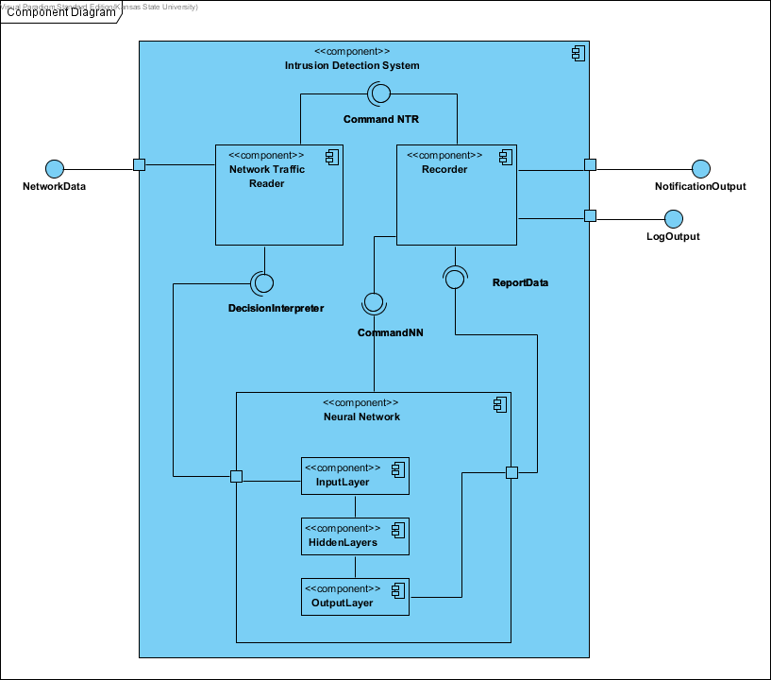
Architecture Design
Architecture is fairly simple from high level
Diagram shows interactions
Three main components
Network Traffic Reader
Neural Network
Input Layer
Hidden Layer
Output Layer
Recorder
Three external nodes
Network Data
Notification Output
Log Output

Slide 8
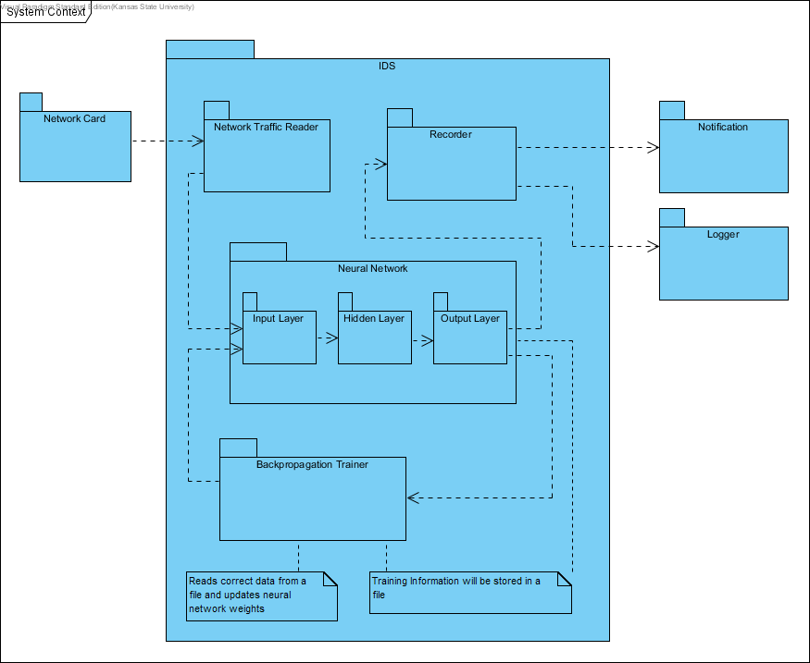
Architecture Design
Package Design
Four main packages:
Network Traffic Reader
Neural Network
Input Layer
Hidden Layer
Output Layer
Backpropogation Trainer
Recorder
Three external nodes
Network Data
Notification Output
Log Output

Slide 9
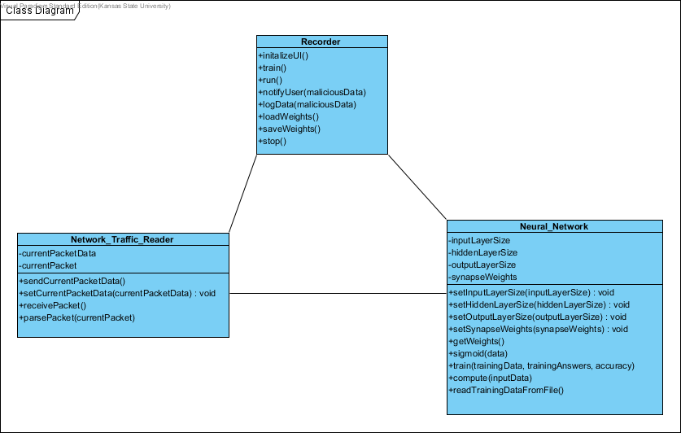
Architecture Design
Class Design Diagram
Operations defined in following slides

Slide 10
Architecture Design
Network Traffic Reader Class

Slide 11
Architecture Design
Neural Network Class

Slide 12
Architecture Design
Neural Network Class

Slide 13
Architecture Design
Recorder Class

Slide 14
Architecture Design
Recorder Class

Slide 15
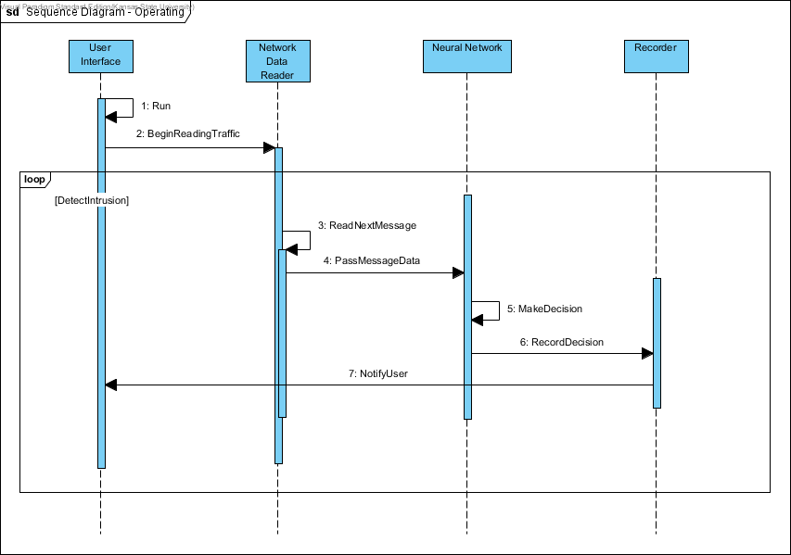
Architecture Design
Operating Sequence Diagram

Slide 16
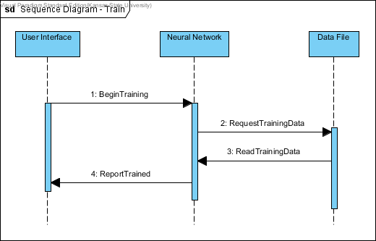
Architecture Design
Train Sequence Diagram

Slide 17
Test Plan
SR1.1 [Critical Requirement]
The system shall be able to read data from the host system network card.
SR2.1 [Critical Requirement]
The system shall be able to interpret the data from the received network traffic and store it in a usable format.
SR3.1 [Critical Requirement]
The system shall be able to determine if the network data received by the host machine is malicious with at least 85% accuracy.
SR3.2
The system shall determine what type of attack is being made to the host network when malicious network traffic is found.
SR4.1 [Critical Requirement]
The system shall be able to train itself through backpropagation on known network traffic data.
SR5.1 [Critical Requirement]
The system shall be able to notify the User of the host system when a malicious attack is encountered.
SR6.1
The system shall be able to log all malicious attacks into a log file.
Notes:
Management:
You all are the Supervisory Committee with Dr. Neilsen being the Major Professor
Technical Inspectors: Tracy Marshall and Keith Moyer
Software Reviews:
This will come in the form of these presentations along with the technical inspections done.
Testing:
A detailed test plan will be given during the second phase of the project, which will assess the critical requirements.
Problem Reporting and Corrective Action:
Any issues reported by the committee or the technical inspectors will be reported and any needed corrective action will take place. Depending on the issue type, it can be noted and documented through the documentation in latter phases or through the GitHub Issue reporting system.
Tools, Techniques and Methodologies:
Visual Studio IDE – Currently Python 3.5 (possibly switching to 2.7 due to TCP/IP libraries)
Documentation is through Microsoft Office 365 Suite of tools
UML Diagrams through Visual Paradigm
Revision Control:
Git via GitHub

Slide 18
Test Plan
Test Case 3: Attack Type
Requirement(s): SR3.2
This test will run the Neural Network package standalone. The test will consist of feeding the Neural Network with test data, capturing the decisions made, and determining that correctness by comparing the decisions made to the actual results. It will then check to determine if the correct attack type was reported compared to the expected outcome.
Test Case 4: Backpropogation Training
Requirement(s): SR4.1
This test will run the Neural Network package standalone. The test will consist of training the Neural Network with the saved training data. If the Neural Network can achieve a correctness similar to Test Case 2 then it will pass the test.
Test Case 1: Capturing Data
Requirement(s): SR1.1; SR2.1
This test will run the Data Traffic Reader and determine if it can capture the data by capturing the output of this package after it reads the data off the network card. The analysis will look at the format of the data to ensure that the data is formatted correctly.
Test Case 2: Correctness Accuracy
Requirement(s): SR3.1
This test will run the Neural Network package standalone. The test will consist of feeding the Neural Network with test data, capturing the decisions made, and determining that correctness by comparing the decisions made to the actual results.
Notes:
Management:
You all are the Supervisory Committee with Dr. Neilsen being the Major Professor
Technical Inspectors: Tracy Marshall and Keith Moyer
Software Reviews:
This will come in the form of these presentations along with the technical inspections done.
Testing:
A detailed test plan will be given during the second phase of the project, which will assess the critical requirements.
Problem Reporting and Corrective Action:
Any issues reported by the committee or the technical inspectors will be reported and any needed corrective action will take place. Depending on the issue type, it can be noted and documented through the documentation in latter phases or through the GitHub Issue reporting system.
Tools, Techniques and Methodologies:
Visual Studio IDE – Currently Python 3.5 (possibly switching to 2.7 due to TCP/IP libraries)
Documentation is through Microsoft Office 365 Suite of tools
UML Diagrams through Visual Paradigm
Revision Control:
Git via GitHub

Slide 19
Test Plan
Test Case 5: Notification
Requirement(s): SR5.1
This test will run the Recorder Package standalone. It will test that it creates a notification when the package receives an input notifying it of a malicious data packet. The notification must have some level of detail about the packet.
Test Case 6: Logging
Requirement(s): SR6.1
This test will be similar to Test Case 5 but will check a log file instead of a notification.
Test Case 7: System Test
Requirement(s): N/A
This test will be a full simulation test initializing and running the application. From a separate application I will inject malicious packets to fake malicious data into the system.
Notes:
Management:
You all are the Supervisory Committee with Dr. Neilsen being the Major Professor
Technical Inspectors: Tracy Marshall and Keith Moyer
Software Reviews:
This will come in the form of these presentations along with the technical inspections done.
Testing:
A detailed test plan will be given during the second phase of the project, which will assess the critical requirements.
Problem Reporting and Corrective Action:
Any issues reported by the committee or the technical inspectors will be reported and any needed corrective action will take place. Depending on the issue type, it can be noted and documented through the documentation in latter phases or through the GitHub Issue reporting system.
Tools, Techniques and Methodologies:
Visual Studio IDE – Currently Python 3.5 (possibly switching to 2.7 due to TCP/IP libraries)
Documentation is through Microsoft Office 365 Suite of tools
UML Diagrams through Visual Paradigm
Revision Control:
Git via GitHub

Slide 20
Test Plan
Test Deliverables
Log file for each test
Environment Needs
Only those needed to run the application
Notes:
Management:
You all are the Supervisory Committee with Dr. Neilsen being the Major Professor
Technical Inspectors: Tracy Marshall and Keith Moyer
Software Reviews:
This will come in the form of these presentations along with the technical inspections done.
Testing:
A detailed test plan will be given during the second phase of the project, which will assess the critical requirements.
Problem Reporting and Corrective Action:
Any issues reported by the committee or the technical inspectors will be reported and any needed corrective action will take place. Depending on the issue type, it can be noted and documented through the documentation in latter phases or through the GitHub Issue reporting system.
Tools, Techniques and Methodologies:
Visual Studio IDE – Currently Python 3.5 (possibly switching to 2.7 due to TCP/IP libraries)
Documentation is through Microsoft Office 365 Suite of tools
UML Diagrams through Visual Paradigm
Revision Control:
Git via GitHub

Slide 21
Formal Technical Inspection Checklist
Inspect Prototype Code
Inspectors:
Tracy Marshall
Keith Moyer
Notes:
Management:
You all are the Supervisory Committee with Dr. Neilsen being the Major Professor
Technical Inspectors: Tracy Marshall and Keith Moyer
Software Reviews:
This will come in the form of these presentations along with the technical inspections done.
Testing:
A detailed test plan will be given during the second phase of the project, which will assess the critical requirements.
Problem Reporting and Corrective Action:
Any issues reported by the committee or the technical inspectors will be reported and any needed corrective action will take place. Depending on the issue type, it can be noted and documented through the documentation in latter phases or through the GitHub Issue reporting system.
Tools, Techniques and Methodologies:
Visual Studio IDE – Currently Python 3.5 (possibly switching to 2.7 due to TCP/IP libraries)
Documentation is through Microsoft Office 365 Suite of tools
UML Diagrams through Visual Paradigm
Revision Control:
Git via GitHub

Slide 22
Risks and Concerns
Loss of data points due to KDD99 expert system data captures
Achieving the accuracy due to loss of data points

Slide 23
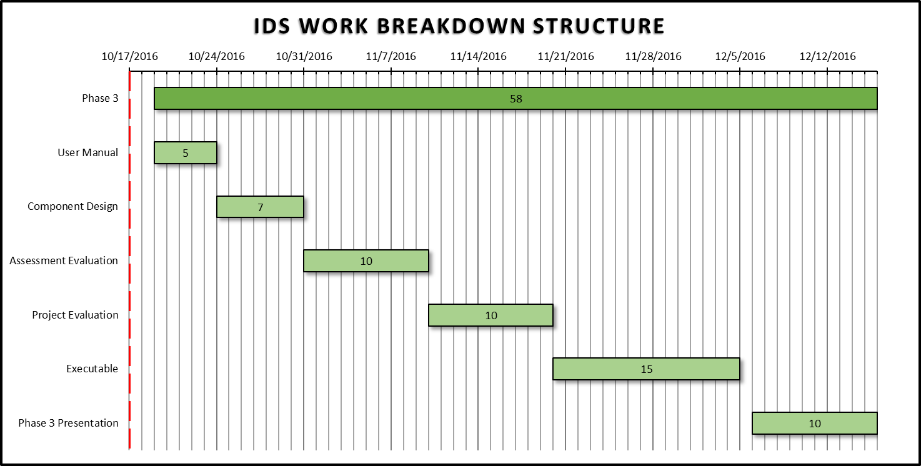
Phase Three Plan

Slide 24
Architecture Prototype Demonstration
GitHub Repository Location:
https://github.com/bneedy/PyIDS
All components of the system are working to some degree
Not fully functional yet – still a prototype
Can read network traffic off network card and determine decision using neural network

Slide 25
Questions and Comments

